Slide 1
Ensemble Learning
Boosting
Short Presentation
Aravind

Slide 2
Overview:
Ensemble learning is a machine learning technique that combines predictions from multiple models (also called "weak learners") to produce more accurate and robust predictions than a single model alone.
Core Concept:
Instead of relying on a single model, this trains multiple models and then combine their outputs to make a final prediction.
Common Techniques:
Bagging: Trains multiple models on different subsets of the training data and then averages their predictions.
Boosting: Sequentially trains models, with each model focusing on the errors made by previous models.
Stacking: Trains multiple models and then uses a meta-learner to combine their predictions.
Benefits:
Improved Accuracy: Ensemble models often achieve higher accuracy than individual models.
Reduced Variance: By averaging predictions from multiple models, ensemble methods can reduce the model's sensitivity to changes in the training data.
Robustness: Ensemble models tend to be more robust to errors and uncertainties in the data.

Slide 3
Examples of Ensemble Algorithms:
Random Forests (Bagging)
AdaBoost (Boosting)
Gradient Boosting Machines (GBM)
Stacking
Applications:
Classification: Identifying categories or labels.
Regression: Predicting continuous values.
Anomaly Detection: Identifying unusual patterns in data.
Why it works:
By leveraging the strengths of diverse models, ensemble methods can reduce bias and variance, leading to improved accuracy and generalization.

Slide 4
Boosting:
AdaBoost, XGBoost, and LightGBM are powerful ensemble learning algorithms that enhance model performance by combining multiple weak learners. Each algorithm employs unique techniques for boosting, such as adaptive weighting in AdaBoost and gradient-based optimization in XGBoost and LightGBM, making them effective for various machine learning tasks. AdaBoost (Adaptive Boosting)

Slide 5
AdaBoost:
Overview:
AdaBoost is one of the first boosting algorithms that combines multiple weak learners, typically decision stumps, to improve classification accuracy.
How It Works:
First, it trains a weak model on the data.
Then, it focuses more on the mistakes made by the first model by giving those misclassified points higher weights.
It repeats this process, training new models that improve where the previous ones failed.
Finally, it combines all weak models into a strong classifier.
Key Steps:
Initialize weights for all samples.
Create a decision stump based on the feature with the highest information gain.
Update weights based on misclassifications.
Normalize weights and repeat until a specified number of learners is reached.

Slide 6
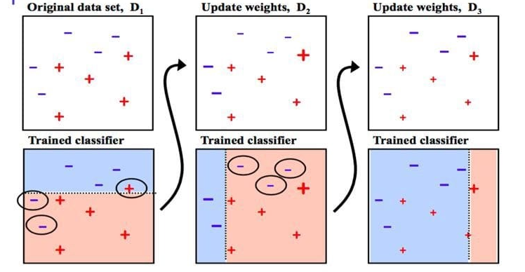
Core idea: Focuses on difficult examples that previous models got wrong
Analogy: Like having a team of specialists who each focus on solving the parts of a problem that others struggle with

Slide 7
AdaBoost
Advantages:
Combines Weak Learners: Creates a strong learner from multiple simple models.
Adaptive Focus: Weights misclassified instances more heavily.
Easy to Implement: Relatively straightforward to use with standard libraries.
Versatile: Can be used for classification and regression.
Disadvantages:
Sensitive to Noise: Outliers can disproportionately affect the model.
Computationally Intensive: Sequential training can be time-consuming.
Potential Overfitting: Can overfit if too many weak learners are used.
Relies on Weak Learner Quality: Performance depends on the base models.

Slide 8
XGBoost (Extreme Gradient Boosting)
Overview:
XGBoost is an optimized implementation of gradient boosting that is highly efficient and scalable, widely used in data science competitions.
How It Works:
It builds an ensemble of decision trees sequentially like AdaBoost, but each tree corrects the errors of the previous ones.
Utilizes a differentiable loss function and gradient descent optimization to minimize errors.
Key Steps:
Initialize the model with a simple prediction (e.g., mean).
Calculate residuals (errors) from the current model.
Train a new decision tree on these residuals.
Update the model by adding the new tree's predictions, scaled by a learning rate.
Repeat until a stopping criterion is met.

Slide 9
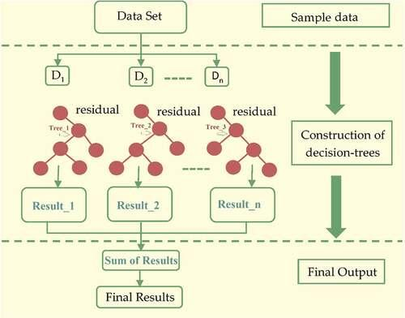
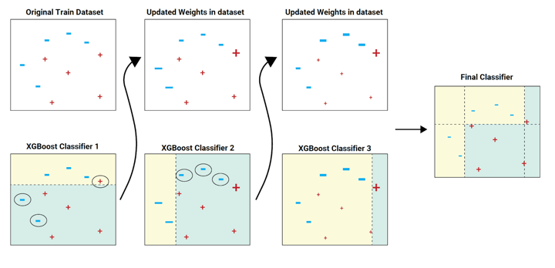
Core idea: Builds models in trees sequentially to correct errors from previous ones
Analogy: Like a team iteratively refining a solution, where each member improves upon the collective work so far

Slide 10
XGBoost
Advantages:
High Accuracy: Often achieves state-of-the-art results.
Fast Training: Utilizes parallel processing for speed.
Regularization: Built-in L1 and L2 to prevent overfitting.
Handles Missing Data: Can learn from data with missing values.
Disadvantages:
Complex Hyperparameters: Many parameters require careful tuning.
Overfitting Risk: Still susceptible to overfitting if not tuned well.
High Memory Usage: Can be memory-intensive with large datasets.
Less Interpretable: Complex ensemble of trees can be hard to understand.

Slide 11
LightGBM (Light Gradient Boosting Machine)
Overview:
LightGBM is designed for distributed and efficient training, particularly on large datasets, and is known for its speed and performance.
How It Works:
Instead of growing trees level by level (like XGBoost), it grows them leaf-wise—this means it expands the branch that reduces the loss the most.
It handles large datasets better and requires less memory.
Key Steps:
Convert continuous features into discrete bins.
Build trees using a leaf-wise strategy to minimize loss.
Optimize the model iteratively by adding trees that focus on the most significant errors.

Slide 12
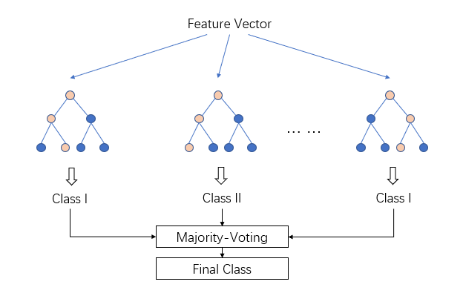
Core idea: Similar to XGBoost but designed for greater efficiency.
Analogy: Like XGBoost but with shortcuts that make it much faster without sacrificing much accuracy.

Slide 13
LightGBM
Advantages:
Very Fast Training: Histogram-based and leaf-wise growth is highly efficient.
Low Memory Consumption: Efficiently handles large datasets.
Handles Categorical Features: Can directly process categorical data.
Scalable: Performs well with massive datasets.
Disadvantages:
Prone to Overfitting: Leaf-wise growth can easily overfit small data.
Sensitive to Parameters: Requires careful tuning for optimal performance.
Less Stable Trees: Leaf-wise growth can lead to less balanced trees.
May Underperform on Small Data: Can struggle with very limited datasets.

Slide 14
Conclusion:
These algorithms are essential tools in machine learning, providing robust solutions for both classification and regression tasks. Their ability to combine weak learners into strong predictive models makes them invaluable in various applications.

